Slide 1


Department of Artificial Intelligence and Data Science
Air Ticket Reservation System
POONGAVIN B (221801036)
YASWANTH P(221801063)
NITHISH S(221801502)

Slide 2
Introduction
This air ticket reservation system is a web-based application designed to streamline the flight booking process, making it quick, simple, and efficient.
Developed using HTML, CSS, and JavaScript, the system provides a user-friendly interface for users to search for available flights, select travel dates, choose destinations, and confirm bookings.
Leveraging the power of front-end technologies, this system ensures a responsive and engaging user experience across various devices.
Key features include real-time fare calculations, interactive seat selection, and the ability to view booking details, creating a seamless and intuitive flight reservation experience.
The system incorporates basic validation checks and user-friendly prompts, ensuring that all user inputs are secure and meet the necessary criteria, reducing the chances of booking errors.

Slide 3
Existing Systems
Amadeus: A comprehensive global distribution system (GDS) used by travel agencies and airlines worldwide. It provides real-time availability, pricing, and booking options, along with solutions for inventory management and customer relationship management.
Sabre: Another widely-used GDS that offers booking and ticketing services for airlines, hotels, car rentals, and other travel sectors. Sabre powers numerous online travel agencies (OTAs) and helps airlines manage inventory and scheduling.
Travelport (Galileo, Worldspan, Apollo): A GDS platform that combines Galileo, Worldspan, and Apollo under Travelport, offering extensive air ticket booking, inventory management, and travel planning solutions. It provides APIs for seamless integration with travel agency websites and apps.
SITA Horizon: A passenger management and reservation system widely adopted by airlines for booking, check-in, boarding, and customer data management. It offers real-time data exchange for better passenger service and operational efficiency.

Slide 4
Advantages and Disadvantages of Existing System
Advantages:
Provides comprehensive, real-time booking options and inventory management.
Supports a wide range of travel segments, including airlines, hotels, and rentals.
Offers strong integration capabilities with third-party travel agencies and OTAs.
Enhances operational efficiency with robust analytics and data tools.
Disadvantages:
High costs and complex fee structures make them less accessible for smaller businesses.
Requires significant training due to system complexity and outdated interfaces.
Limited flexibility and customization for non-standard or smaller-scale needs.
Frequent updates can disrupt functionality temporarily.

Slide 5
Proposed System
Cloud-Based Reservation System - Scalable, flexible, and accessible from any device with real-time updates.
AI-Enhanced Booking System - Offers personalized travel options and dynamic pricing based on user behavior and demand.
Blockchain-Based Reservation System - Provides secure and transparent transactions, ensuring data integrity and reducing fraud.
Mobile App-Based Reservation System- Convenient for users with features like mobile wallet integration and real-time flight status updates.
Self-Service Kiosk System - Allows passengers to quickly book and manage tickets without the need for a human agent.
Voice-Activated Reservation System - Allows users to book tickets and manage itineraries using voice commands, offering hands-free convenience.

Slide 6
Advantages and Disadvantages of Proposed System
Advantages:
Enhanced user experience through personalization and convenience.
Increased security and transparency, particularly with blockchain integration.
Scalability and flexibility for handling large volumes of bookings.
Reduced human intervention, leading to cost savings and faster processing.
Disadvantages:
High initial development and integration costs, especially for advanced systems like AI or blockchain.
Potential complexity in implementation and maintenance, requiring specialized knowledge.
Privacy concerns and data security risks, especially with cloud and mobile platforms.
Dependence on technology, which could lead to disruptions in case of system outages or failures.

Slide 7
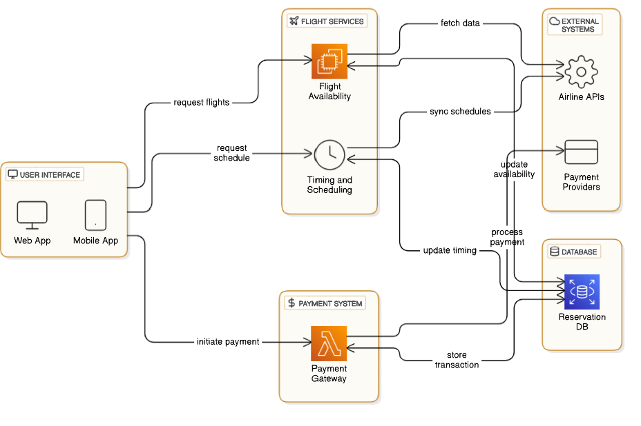
Architecture Diagram

Slide 8
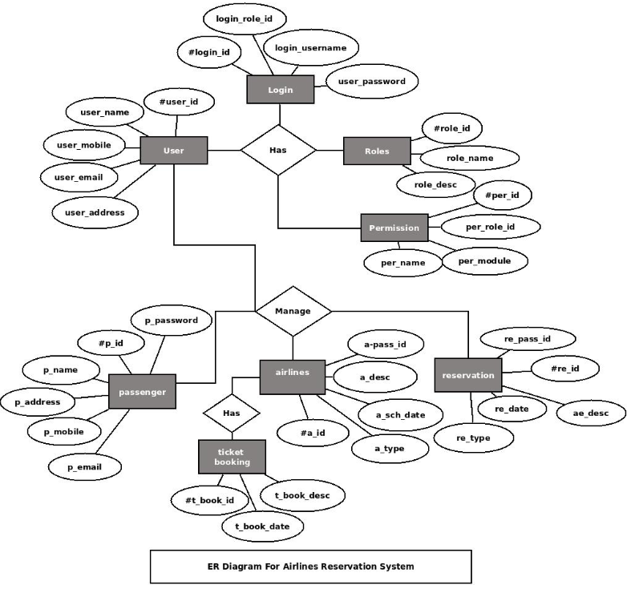

ER Diagram:

Slide 9
LIST OF MODULES:
HOME PAGE
LOGIN PAGE
CONTACT US
DEALS MODULE
SEARCH MODULE

Slide 10
MODULES:
1. Home Page:The Home Page serves as the welcoming interface for users, providing an overview of the system's features. It typically includes a user-friendly layout showcasing navigation options to different sections such as flight search, current deals, and user account access.
2. Login Page:The Login Page allows registered users to securely access their accounts by entering their credentials (username/email and password). It should include options for password recovery, a "Remember Me" checkbox, and potentially a two-factor authentication feature for enhanced security.
3. Deals Page:The Deals Page presents users with current promotions, discounts, and special offers on flights. This module is designed to attract budget-conscious travelers by showcasing limited-time discounts, seasonal promotions, and exclusive deals for frequent flyers or members.

Slide 11
MODULES:
4. Search Page:The Search Page is a core component where users input flight details such as departure and destination airports, travel dates, and passenger information. Advanced features may include filters for direct or connecting flights, preferred airlines, and flight classes. The results should be displayed in an organized manner, allowing users to compare options based on price, duration, and other criteria. This page needs to be intuitive to facilitate quick and effective flight searches.
5. Booking Page:The Booking Page is where users finalize their flight reservations. It includes a detailed summary of selected flights, passenger details, pricing breakdowns, and any additional services (e.g., seat selection, meal preferences). Users can review and confirm their booking, input payment information, and check or agree to terms and conditions. It should also provide an option for adding travel insurance or other extras. A clear, secure, and seamless booking experience helps ensure successful transactions.

Slide 12
TESTING:
UNIT TESTING:
Unit testing is a software testing method where individual components or functions of a program are tested separately to verify their correctness. This type of testing is typically automated and carried out by developers during the coding phase to ensure that each small, isolated "unit" of the code works as intended. By running unit tests, developers can catch bugs early, improve code quality, and make future code refactoring safer, as passing tests confirm that changes haven’t broken existing functionality. Unit tests also act as a form of documentation, showing the expected behavior of functions or components.
FUNCTIONAL TESTING:
Functional testing for an air ticket reservation system ensures that essential features, like flight search, seat selection, booking, payment, and confirmation, work as expected. Testers verify each function through real-world scenarios to ensure smooth user interactions, accurate fare calculations, proper data validation, and reliable error handling. Both manual and automated tests are used: manual tests capture issues needing human judgment, while automated scripts handle repetitive tasks like form submissions and payment processing. This testing guarantees that the reservation system provides a seamless and reliable booking experience for customers.

Slide 13
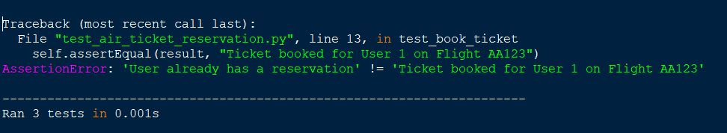
Unit Testing

Slide 14
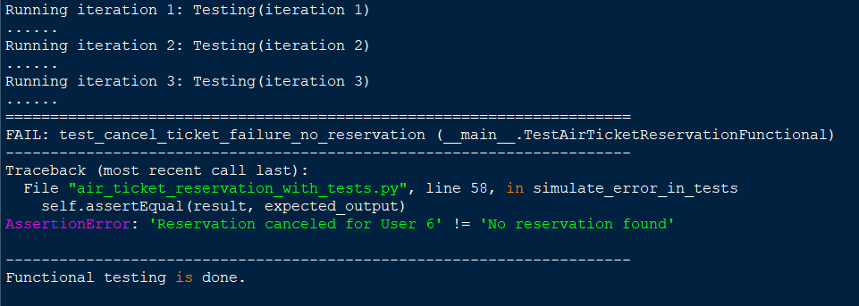
Functional Testing

Slide 15
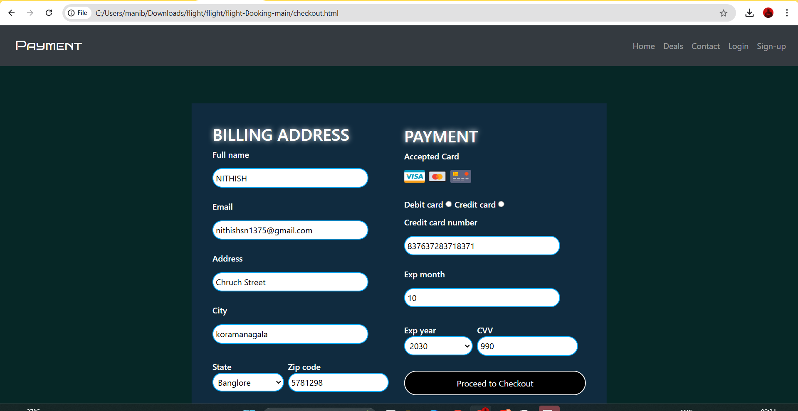
OUTPUT:

Slide 16
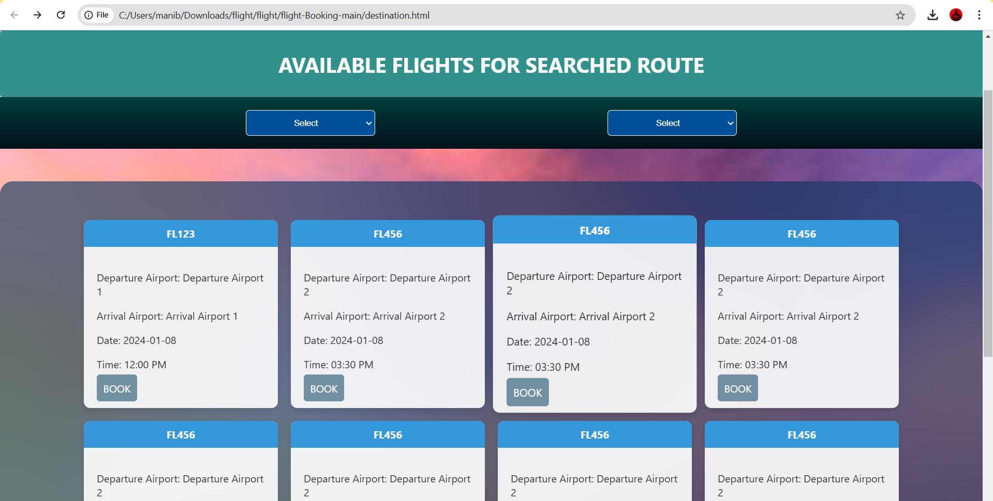
OUTPUT:

Slide 17
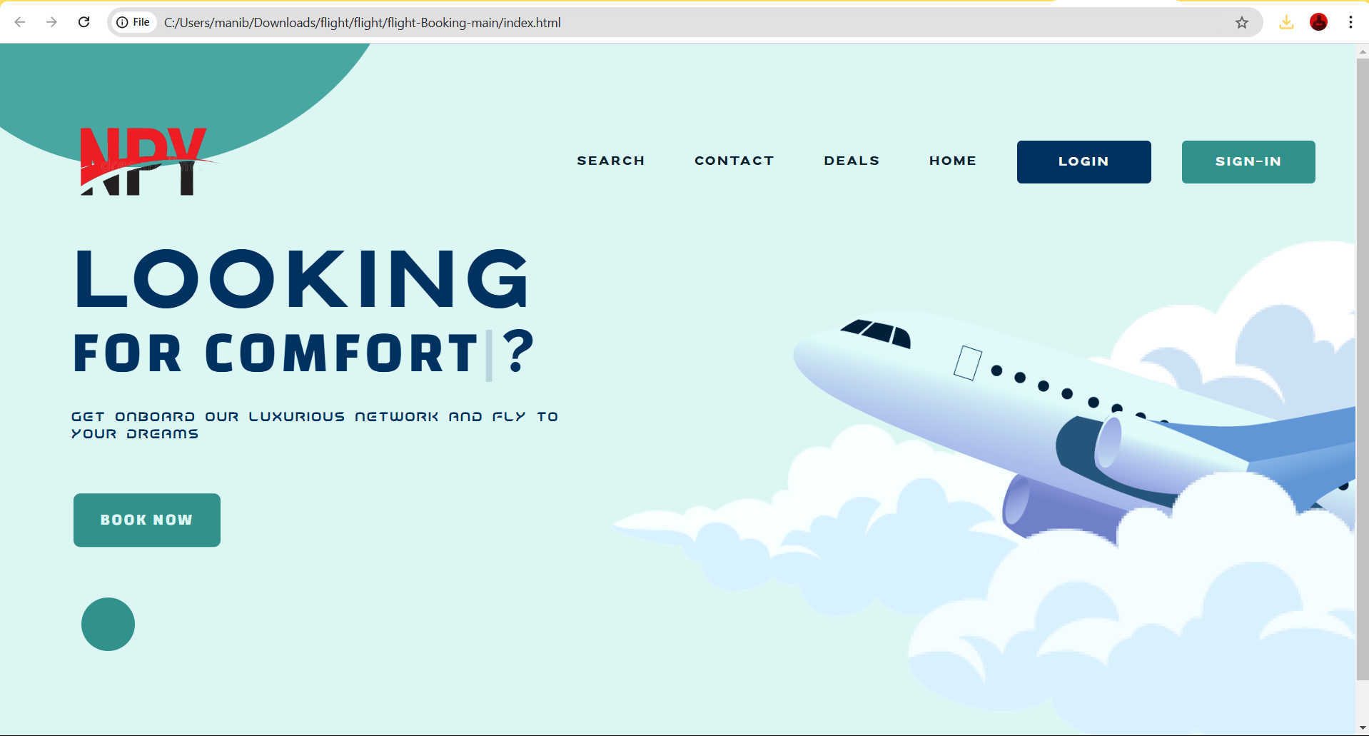
HOME PAGE:

Slide 18
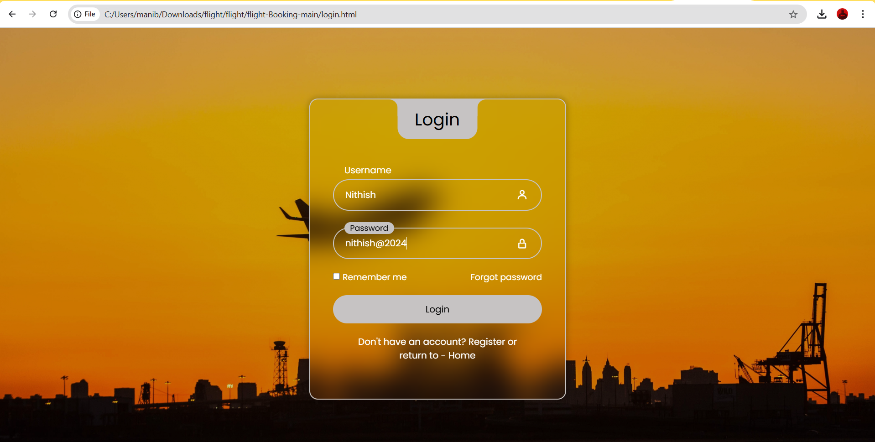
LOGIN PAGE:

Slide 19
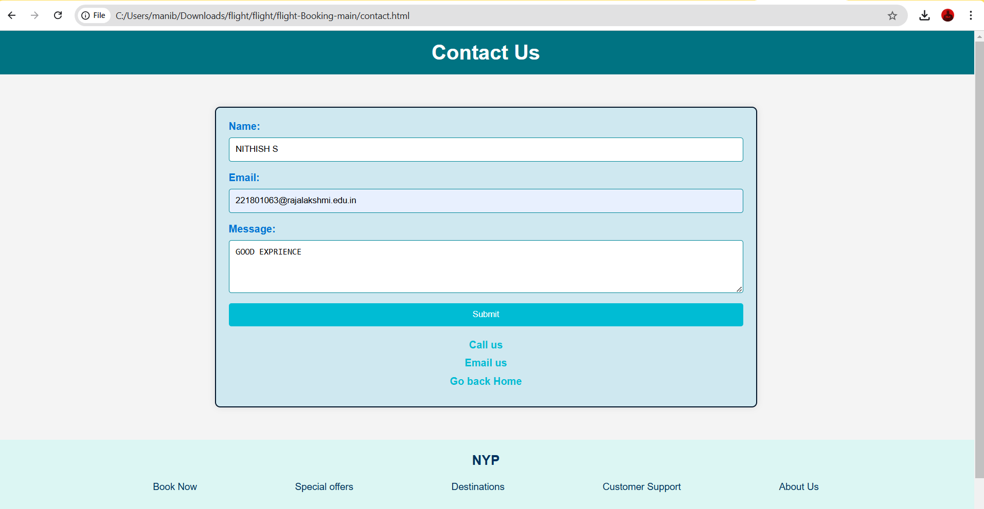
CONTACT US:

Slide 20
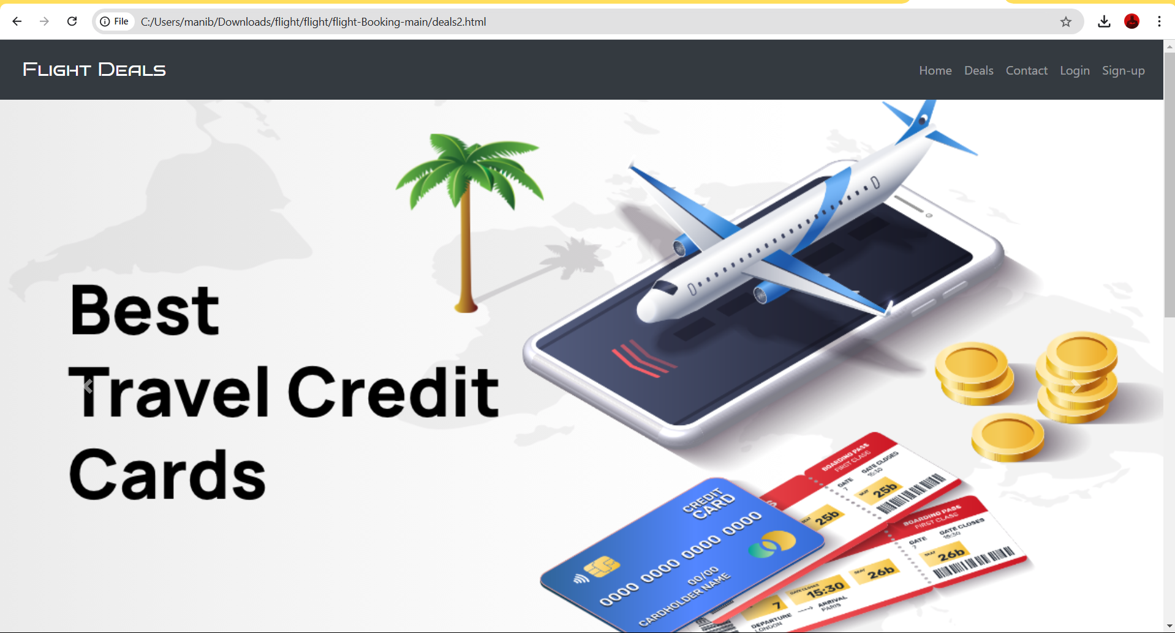
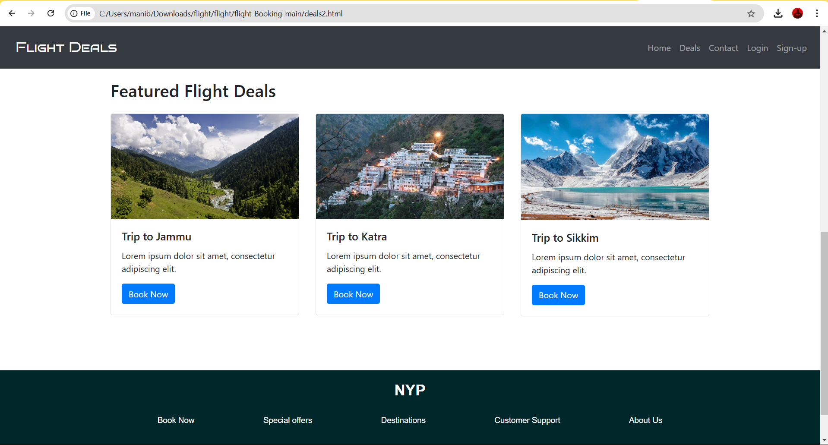
DEALS MODULE:

Slide 21
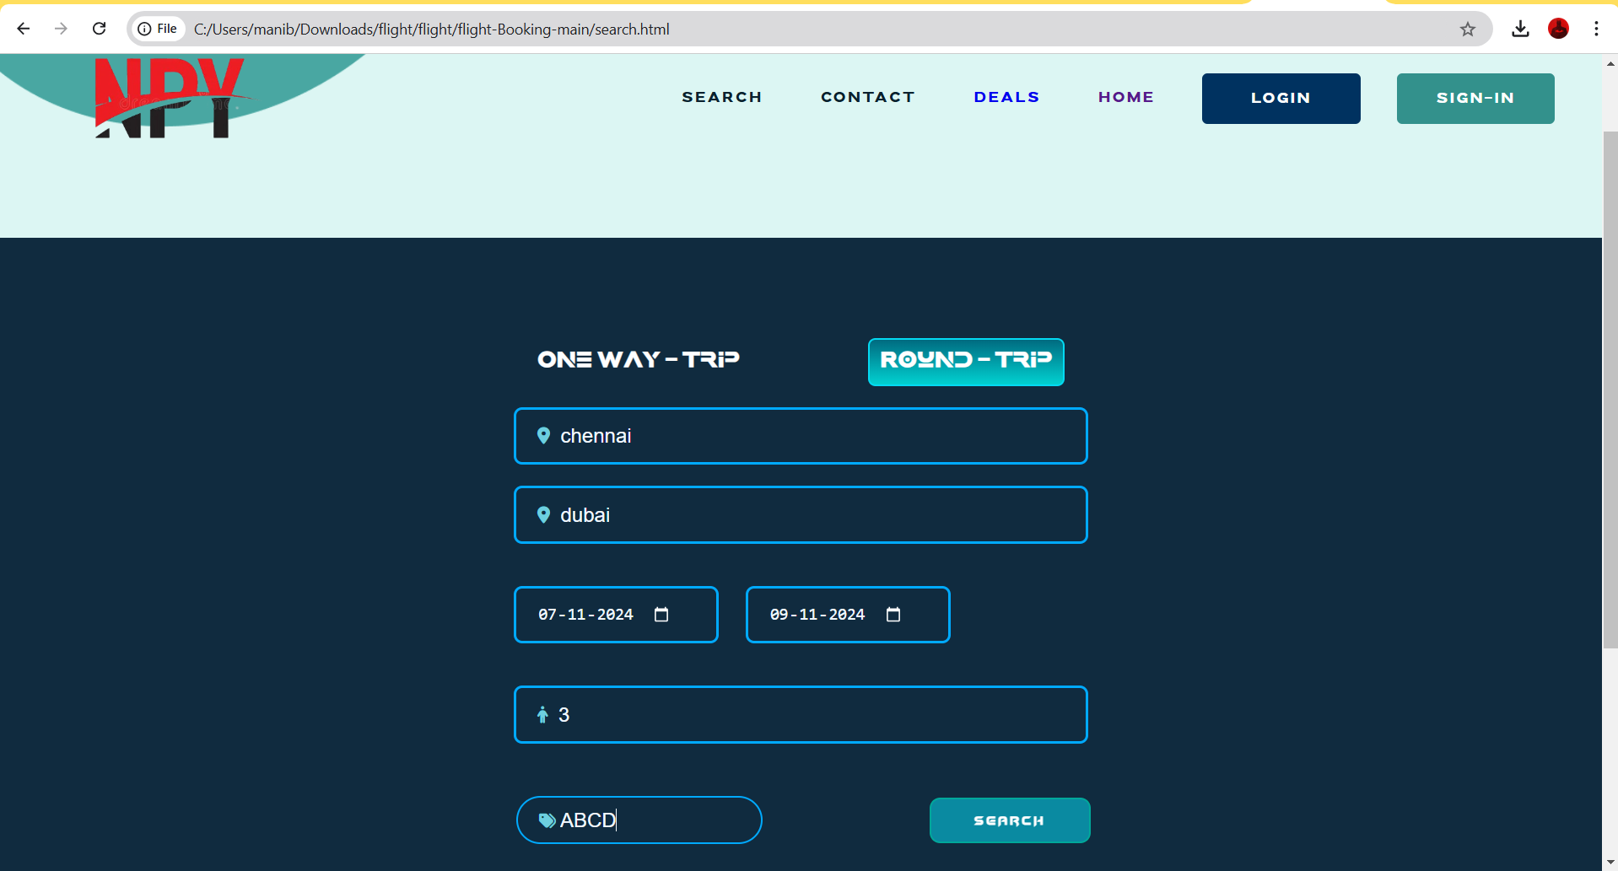
SEARCH MODULE:

Slide 22
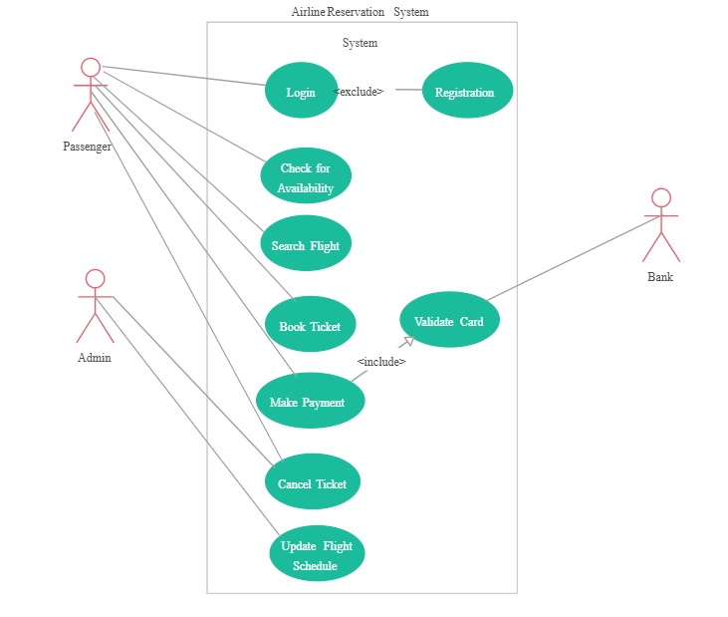
Activity Diagram

Slide 23
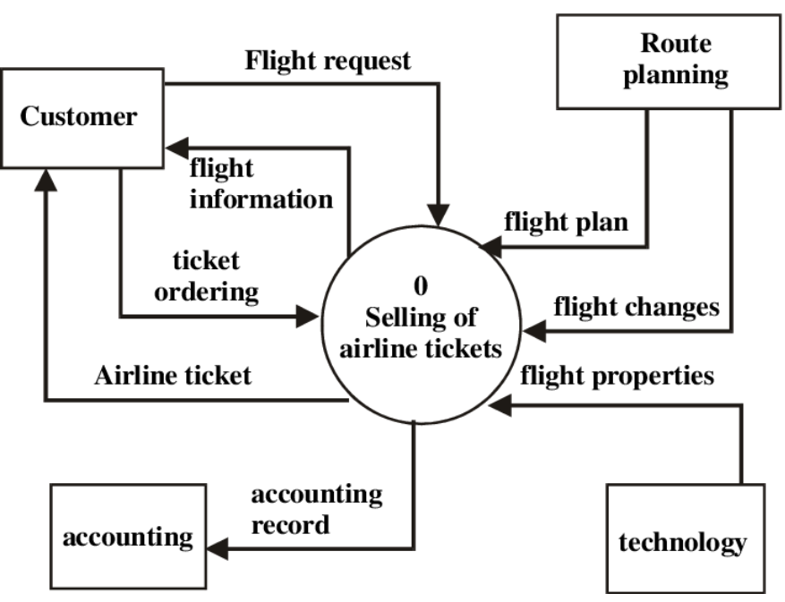
Data Flow Diagram

Slide 24
Conclusion:
For the air ticket reservation system, the conclusion highlights the successful development and implementation of a streamlined, user-friendly platform for booking flights. This system has achieved the core objectives of simplifying the ticket reservation process, improving customer convenience, and enhancing operational efficiency for airline operators. With features like real-time availability, secure payment processing, and seamless booking management, the system effectively meets the requirements of modern travelers. Additionally, by automating reservations and reducing manual intervention, it contributes to reducing errors and improving overall service quality. Future improvements could involve adding personalized recommendations, loyalty program integration, and enhanced analytics for better demand forecasting.

Slide 25
References:
1) Ilhan Tunc, Atakan Yasin Yesilyurt, Mehmet Turan Soylemez(2019). "Intelligent Traffic Light Control System Simulation for Different Strategies with Fuzzy Logic Controller." 11th International Conference on Electrical and ElectronicsEngineering(ELECO).
Link: https://ieeexplore.ieee.org/document/8990313
2) Roxanne Hawi, George Okeyo,Michael Kimwele(2017). "Smart traffic light control using fuzzy logic and wireless sensor network." 2017 Computing Conference. Link:https://ieeexplore.ieee.org/document/8263420
3) Mahabir Singh, T. V. Vijay Kumar(2011),”Fuzzy Logic Based Adaptive Traffic Signal Control System”, International Journal of Computer Applications. Link:https://www.researchgate.net/publication/220538301_Fuzzy_Logic_Based_Adaptive_Traffic_Signal_Control_System
4) Shikha Tripathi, Anand Singh Jalal (2015) “Optimization of Traffic Signals Using Fuzzy Logic”, 2nd International Conference on Computing for Sustainable Global Development (INDIACom).
Link:https://ieeexplore.ieee.org/document/7100357

Slide 26
Thank You

